Slide 1
FULL-STACK PROJECT REVIEW
STUDENT RESULT PORTAL
R . E L A C K E Y A - 2 0 C S 1 0 3 6 G . K A M A L I G O U D H A M -
2 0 C S 1 0 3 7
BATCH-10

Slide 2
PROBLEM STATEMENT
The current result management system of a organisation is fragmented and inefficient, leading to delays, errors, and inconsistencies in the processing and distribution of results.
The server issues make it difficult for students to access the portal during result publication. This causes frustration and inconvenience for students, and negatively impacts the reputation of the organisation.
For most result management system,there is an absence of a CGPA calculator which makes it difficult for students to calculate their overall performance.

Slide 3
OBJECTIVES
To provide a convenient and efficient way for students and faculty to access and manage academic records.
Design a user-friendly interface that is easy to navigate, even for users with limited technical skills.
Ensure high availability and scalability of the result management system, to handle large volumes of data and user traffic.
Develop a system for automated grading and calculation of student results, reducing manual effort and improving accuracy.
Implement a robust and accurate CGPA calculation algorithm, to ensure accurate calculation and display of grades and GPA.

Slide 4
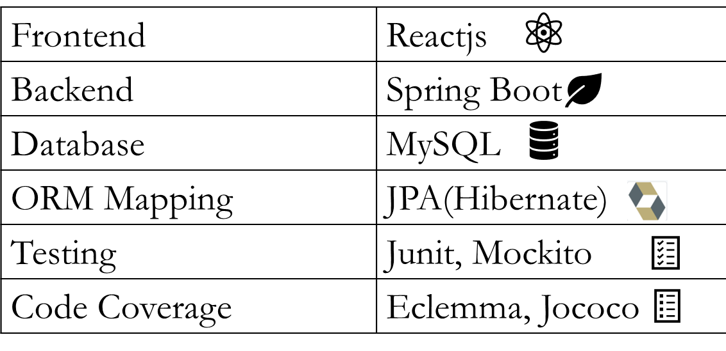
TECHNOLOGY STACK

Slide 5
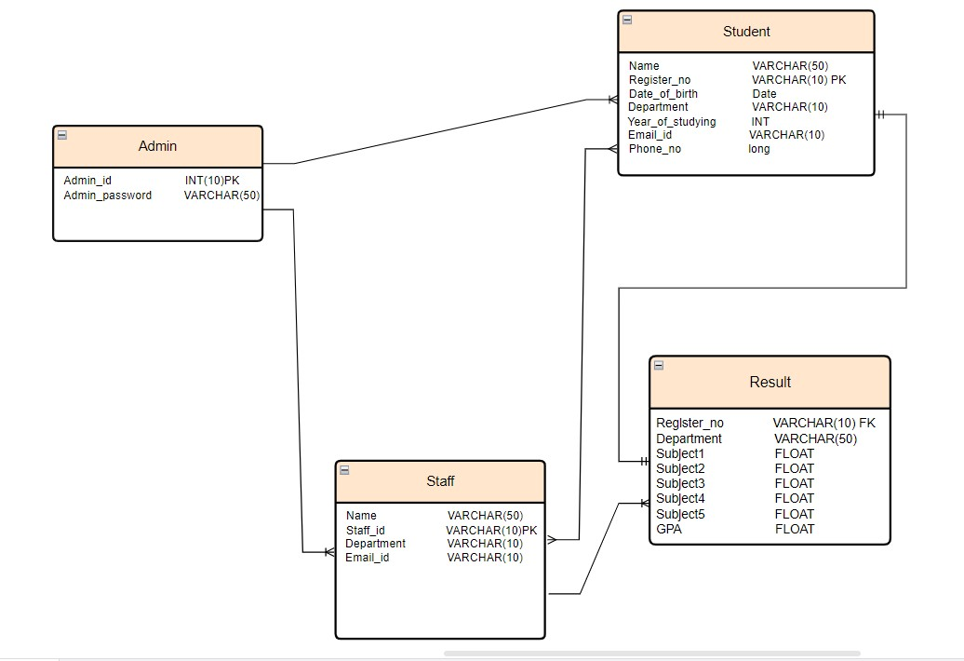
Entity-Relationship Diagram

Slide 6
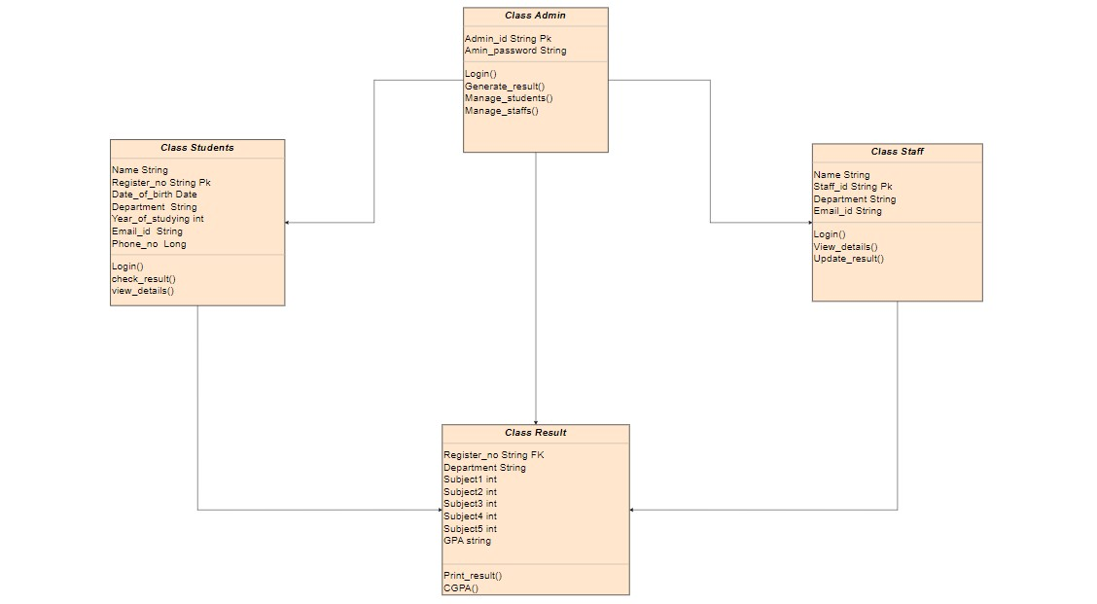
Class Diagram

Slide 7
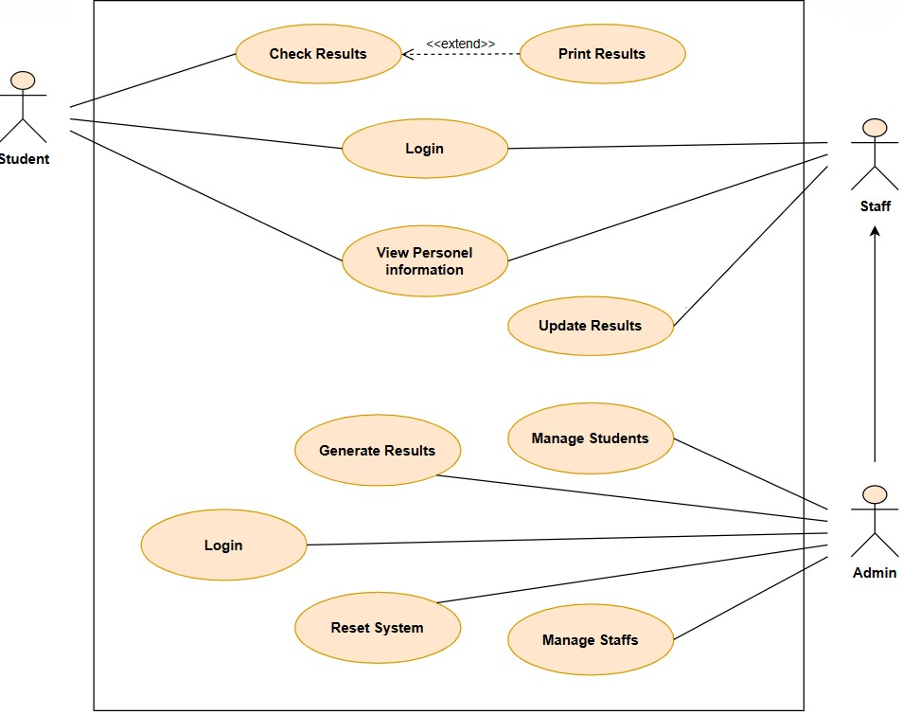
Use-Case Diagram

Slide 8
Establish a system for providing feedback to students about their performance, including detailed explanations of grades and assessments, and opportunities for students to ask questions and receive clarification.
FUTURE
IMPLEMENTATION
Establish a system for recognizing and rewarding academic excellence, such as scholarships, awards, or other forms of recognition, based on CGPA.

